Slide 1
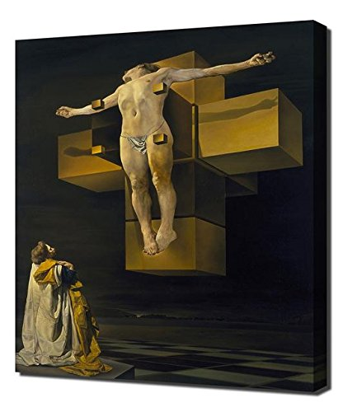
Christianity

Slide 2
Christianity: topics
The Christian Myth
Jesus
As Messiah
The Christian Bible
Relation to Jewish Bible
The New Testament
How we got here: translations
Manuscript transmission
Canon formation

Slide 3
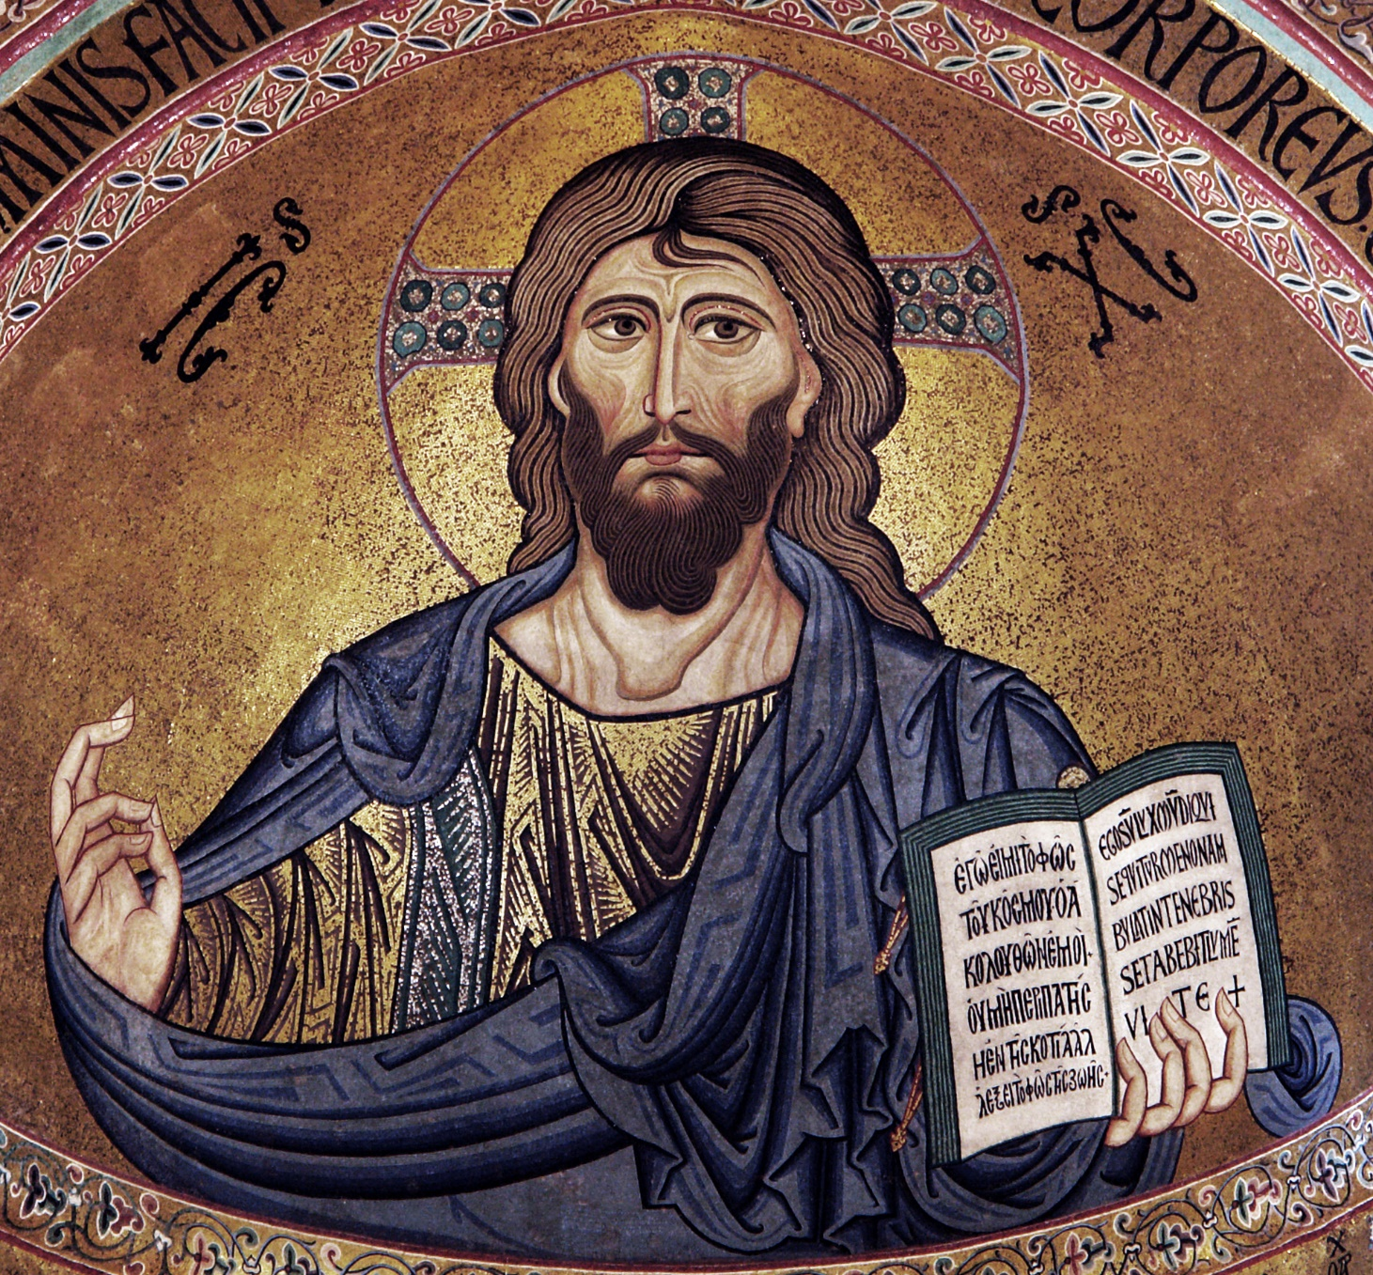
Jesus

Slide 4
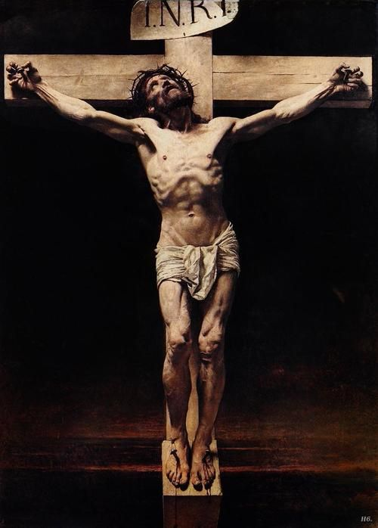
Significance of Jesus
Messiah/Christ
Son of God
2000 years ago, in Palestine/Israel
Death & resurrection
Salvation from sin
Reversal of fall of Adam

Slide 5
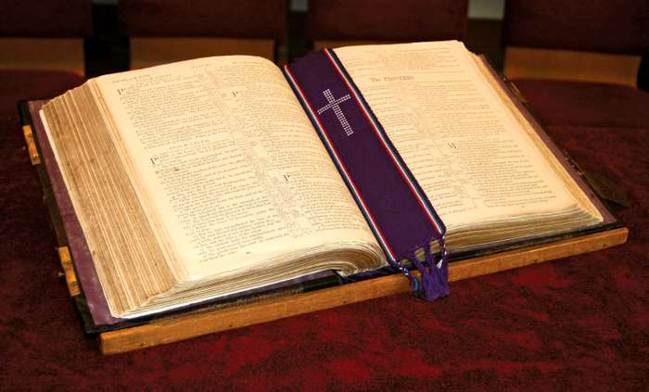
The (Christian) Bible

Slide 6
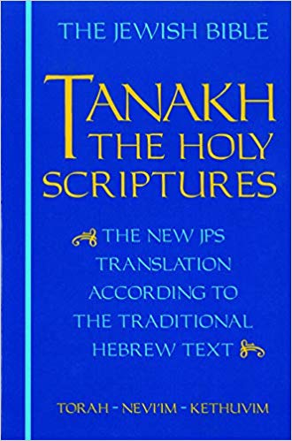
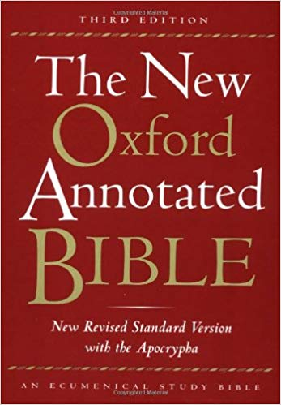
Differences from Jewish Bible

Slide 7
First difference: addition of New Testament
Jewish Tanakh/Bible includes 39 books
E.g., Genesis, Exodus, Leviticus, prophets like Jeremiah, Isaiah, writings like
Written (mostly) in Hebrew
All texts earlier than about 200 BCE
Accepted as Christian scripture under the title of “Old Testament” (or “First Testament,” etc.)
New Testament, includes 27 books
E.g., Gospel of Matthew, Mark, Luke, John, Letters of Paul, etc.
Written entirely in (ancient) Greek
All texts later than about 50 CE
Accepted by all (or nearly all) Christians, but not by Jews

Slide 8
Second difference: order of Tanakh/OT books
Jews divide their Tanakh into three sections
Torah (Law)
Nevi’im (Prophets)
Kethuvim (Writings)
Christians organize the books of their Old Testament in a different order, ending with the Prophets

Slide 9
Third difference: inclusion of additional books
Protestant OT: 39 books (same as Tanakh)
Catholic OT: 46 books
Add books like 1 and 2 Maccabbees, Judith, Tobit
Orthodox OT: 49 books
Add books like 3 and 4 Maccabees, 3 Esdras

Slide 10
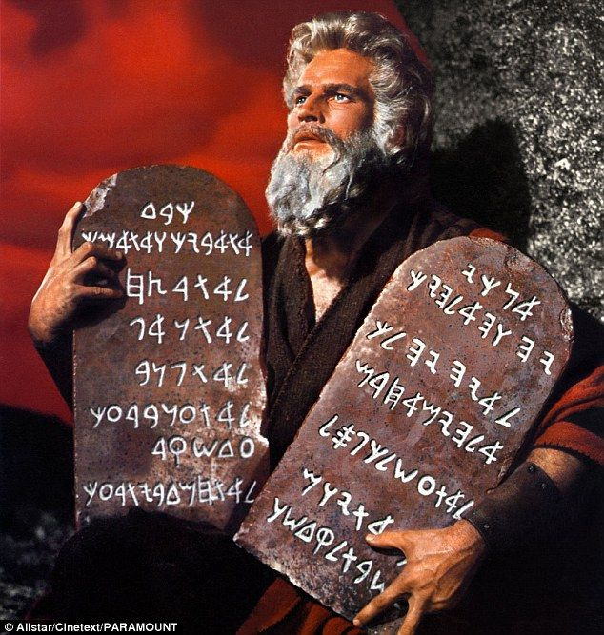
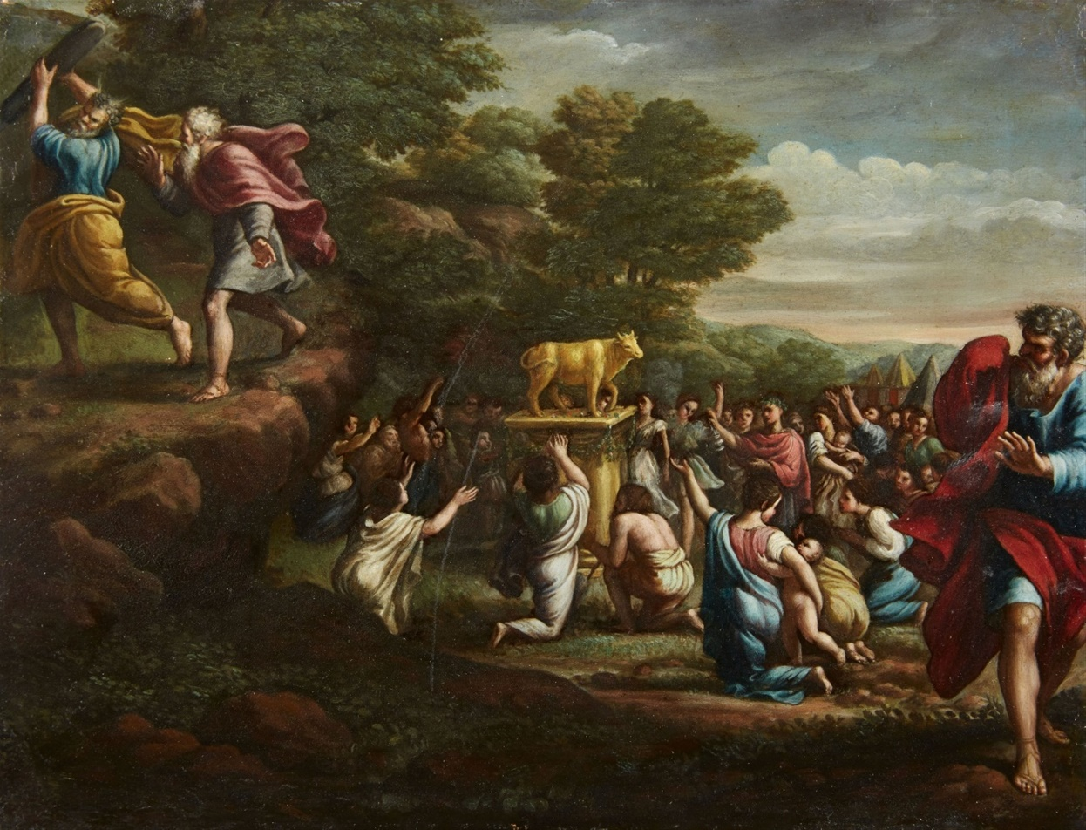
Covenants & New Covenants

Slide 11
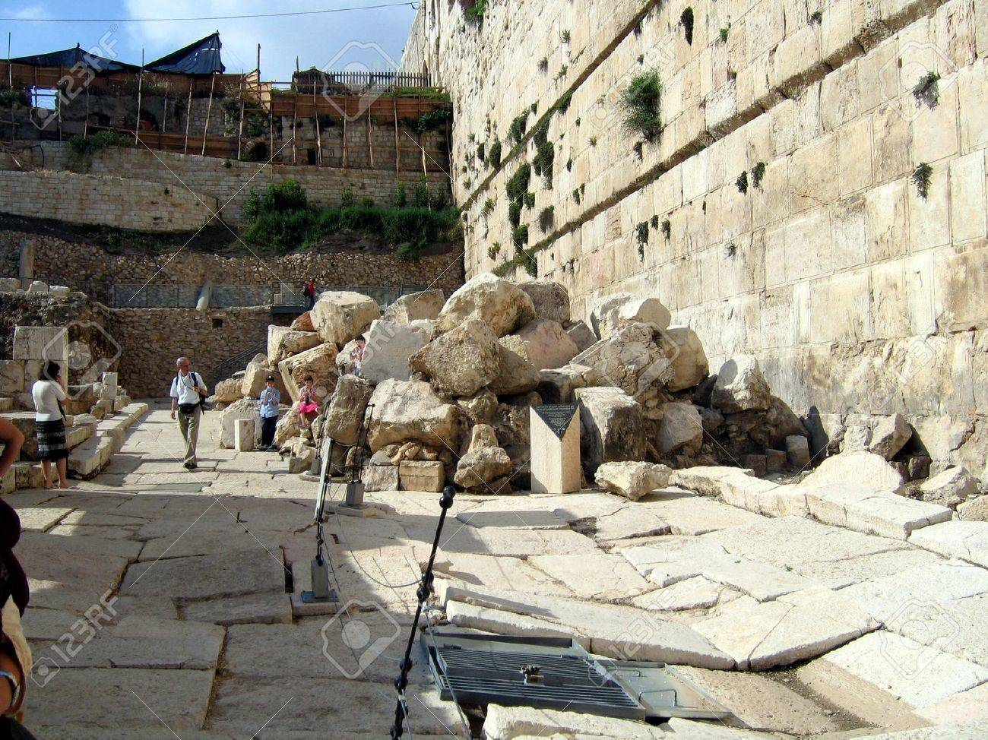
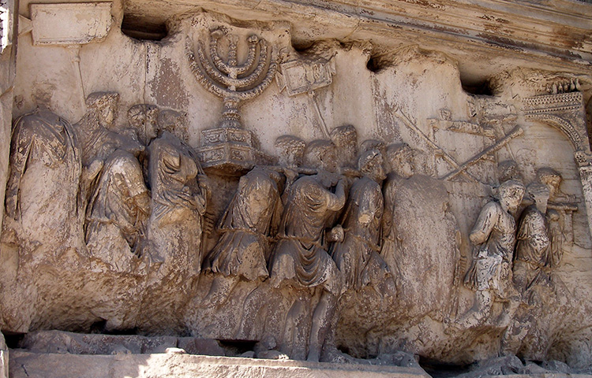
Destruction of Jerusalem Temple, 70 CE
Ruins of Temple
Panel from Arch of Titus

Slide 12
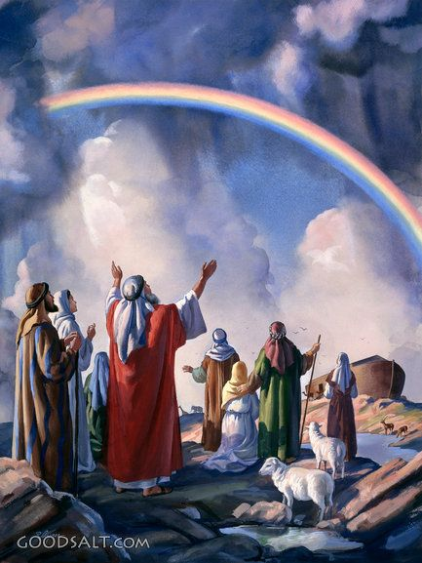
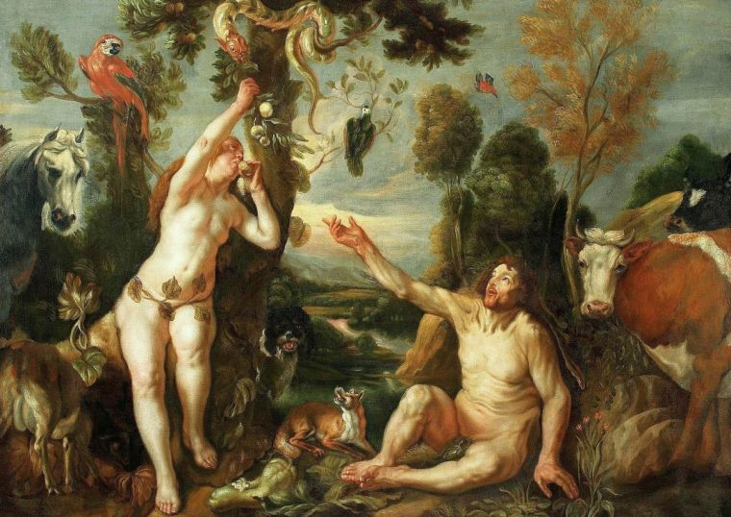
Universal covenants

Slide 13
The New Testament

Slide 14
Matthew 8:1-4 (NRSV)
“When Jesus had come down from the mountain, great crowds followed him; 2 and there was a leper who came to him and knelt before him, saying, “Lord, if you choose, you can make me clean.” 3 He stretched out his hand and touched him, saying, “I do choose. Be made clean!” Immediately his leprosy was cleansed. 4 Then Jesus said to him, “See that you say nothing to anyone; but go, show yourself to the priest, and offer the gift that Moses commanded, as a testimony to them.”

Slide 15
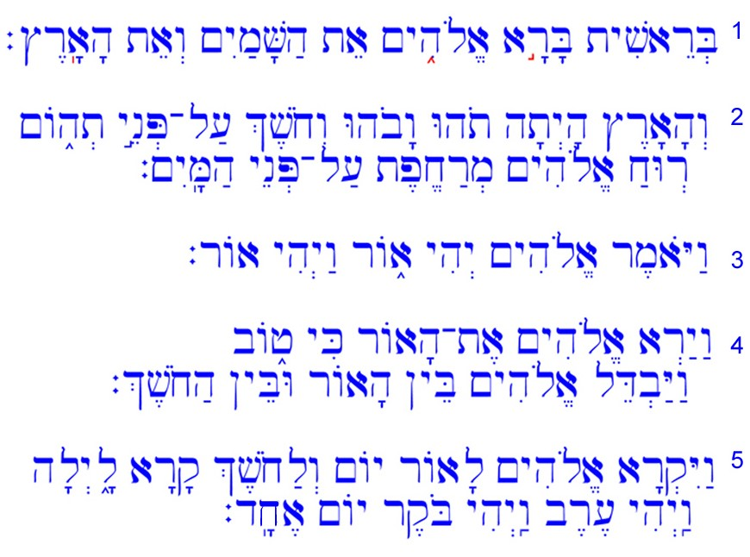
Hebrew Language (Tanakh/Old Testament)

Slide 16
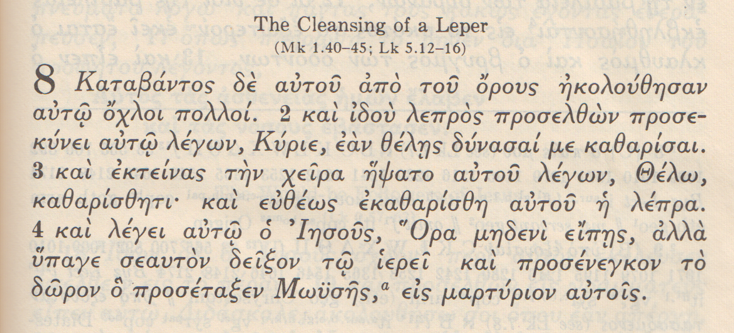
Ancient Greek language (New Testament)

Slide 17
Updated translations
RSV 2 Corinthians 11:25
NRSV 2 Corinthians 11:25
“Three times I have been beaten with rods; once I was stoned. Three times I have been shipwrecked; a night and a day I have been adrift at sea.”
“Three times I was beaten with rods. Once, I received a stoning. Three times I was shipwrecked; for a night and a day I was adrift at sea.”

